Slide 1

Cultural Considerations in Group Intervention

Slide 2
Pre-training survey
Please fill out the survey below regarding past experience with group interventions.
Pre-training Survey

Slide 3

Part I: Cultural Competence in Therapeutic Practice

Slide 4

What is Culture?
Customs, arts, social institutions, and achievements of a particular nation, people, or other social group. (Oxford Press)

Slide 5

Why is Culture Important to Consider in Psychotherapy?
Ethnocultural difference influence a wide variety of domains critical to the psychotherapeutic process.
(Marsella,1993)

Slide 6
What is Cultural Competence?
“Cultural competence is the ability to engage in actions or create conditions that maximize the optimal development of client and client systems. Multicultural counseling competence is defined as the counselor's acquisition of awareness, knowledge, and skills needed to function effectively in a pluralistic democratic society (ability to communicate, interact, negotiate, and intervene on behalf of clients from diverse backgrounds), and on an organizational/societal level, advocating effectively to develop new theories, practices, policies, and organizational structures that are more responsive to all groups”
(D. W. Sue & Torino, 2005).

Slide 7
Different Dimensions of Cultural Competence
Attitudes/Beliefs
Knowledge
Skills
Sue & Torino, 2005
Notes:
Awareness:
-of potentially interfering biases, values
-intellectual knowledge, but not much practice getting in touch w/ these
-emotional impact
Knowledge:
-can nonjudgmentally see and accept clients’ worldviews (cultural role taking)
-cognitive empathy
-practical knowledge about client background, situation, perspective
-sociopolitical system
Skills:
-generate verbal and nonverbal helping responses
-accurate verbal and non-verbal communication
-exercise institutional intervention skills on behalf of clients when appropriate
-be able to anticipate the impact of their helping styles and of their limitations on culturally diverse clients
-Able to play helping roles characterized by an active systemic focus, which leads to environmental interventions. Not restricted by the conventional counselor/therapist mode of operation.
-consistent w/ client life experiences and cultural values
-FOR EXAMPLE: Studies have consistently revealed that (a) economically and educationally marginalized clients may not be oriented toward “talk therapy”; (b) self-disclosure may be incompatible with the cultural values of Asian Americans, Hispanic Americans, and American Indians; (c) the sociopolitical atmosphere may dictate against selfdisclosure from racial minorities and gays and lesbians; (d) the ambiguous nature of counseling may be antagonistic to life values of certain diverse groups; and (e) many minority clients prefer an active/directive approach over an inactive/nondirective one in treatment
-therapy has historically assumed the same approaches are equally effective with all clients

Slide 8
Two Different Levels of Cultural Competence
Personal/individual competence
Organizational/system levels
Sue & Sue, 2016

Slide 9
Competence in Alternative Helping Roles
More than one-to-one therapy
Consultant, change agent, teacher, advocate
More alternatives:
  Having a more active helping style
  Working outside the office
  Environmental focus
  Encountering vs. having
  Prevention over remediation
  Shouldering responsibility
  (Sue & Sue, 2016)

Slide 10

Culturally Responsive Practitioners
“An active, developmental, and ongoing process...that is aspirational rather than achieved.”
(Sue & Sue, 2015)

Slide 11
Common Examples of Cultural Mishaps Among Practitioners
Among Western-trained counseling/mental health professionals
They are insensitive to the needs of their culturally diverse clients; do not accept, respect, and understand cultural differences; are arrogant and contemptuous; and have little understanding of their prejudices (Ridley, 2005; Thomas & Sillen, 1972)
Clients of color, women, and people who identify as LGBTQIA+ frequently complain that they feel abused, intimidated, and harassed by nonminority personnel (Atkinson, Morten, & Sue, 1998; President’s Commission on Mental Health, 1979).

Slide 12

Common Examples of Cultural Incompetence Among Practitioners
Discriminatory practices in mental health delivery systems are deeply embedded in the ways in which the services are organized and in how they are delivered to minority populations and are reflected in biased diagnoses and treatment, in indicators of dangerousness, and in the type of people occupying decision-making roles (Parham et al., 2011; Cross, Bazron, Dennis, & Isaacs, 1989).
Mental health professionals continue to be trained in programs in which the issues of ethnicity, gender, and sexual orientation are ignored, regarded as deficiencies, portrayed in stereotypic ways, or included as an afterthought (Ponterotto et al., 2006; Ratts & Pedersen, 2014).

Slide 13

In Addition to Cultural Competence...
Effective Practitioners must display…
Cultural humility
  Openness to diversity
  (Chao, Wei, Spanierman, Longo, & Northart, 2014)
  Respect for others, egalitarian stance, diminished superiority over clients
    (an “other orientation” vs. self-orientation)
Notes:
Cultural humility:
-a way of being
-virtues and dispositions inherent in the attitudes that counselors hold toward their clients (as opposed to cult. Comp., which is more a way of doing)
-considered very important by socially marginalized groups
-correlated with a higher likelihood of continuing in treatment
-strongly related to the strength of the therapeutic alliance
Related to perceived benefit and improvement in therapy
-perhaps equally as important as cultural competence (Hook et al., 2013; Owen et al., 2014).
Other orientation vs self orientation:
Self-orientation (concern for one’s expertise, training, credentials, and authority)
Provide example of culturally humble and a non-culturally humble response to a client

Slide 14

Social Justice and Cultural Competence
Social justice and multicultural approaches to therapy (Ratts, Singh, Nassar-McMillan, Butler, & McCullough, 2015)
“Differences in identity—and related struggles for place and power—are woven throughout our history and social and political culture. While diversity is a hallmark and strength of our nation, the path toward common ground, mutual respect, and equity has been rocky for nearly every religious, racial, and ethnic group that has become part of the American fabric along the way.”
National Association of School Psychologists. (2016). Understanding Race and Privilege [handout]. Bethesda, MD: Author.

Slide 15
Implications for Clinical Practice
Know that the definition of multiculturalism is inclusive and encompasses race, culture, gender, religious affiliation, sexual orientation, age, disability, and so on.
When working with diverse populations, attempt to identify culture-specific and culture universal domains of helping.
Be aware that persons of color, people of diverse gender identity and sexual orientation, women, and other groups may perceive mental illness/health and the healing process differently than do European American men.
Sue & Sue, 2016

Slide 16
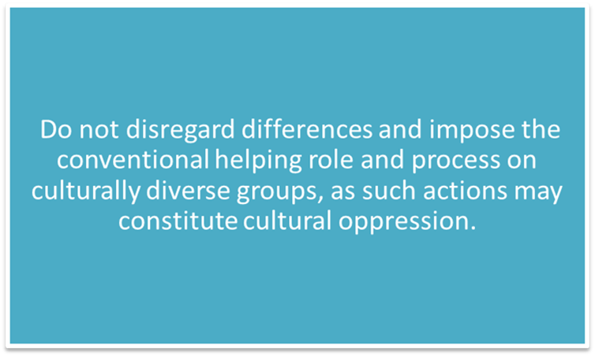
Implications for Clinical Practice
Be aware that EuroAmerican healing standards originate from a cultural context and may be culture-bound.
Realize that the concept of cultural competence is more inclusive and superordinate than is the traditional definition of clinical competence.
As long as counselors and therapists continue to view European American standards as normative, they may judge others as abnormal.
Do not fall into the trap of thinking “good counseling is good counseling.”
Sue & Sue, 2016

Slide 17


Implications for Clinical Practice
Understand that one's multicultural orientation, cultural humility, is very important to successful multicultural counseling.
Sue & Sue, 2016

Slide 18

Part II: Multicultural Considerations for Group Interventions

Slide 19

Culturally Informed Groups with Drs. Hess & Pejic

Slide 20
Check-in
When was the last time you had to think about your ethnicity, race, gender identity, ability level, religion, and/or sexual orientation? What provoked you to think about it or acknowledge it?
How do you respond when others make negative statements towards individuals of a different ethnicity, race, gender, ability level, religion, sexual orientation, and/or gender identity than yourself?
If you recognized your privilege, what did you do with this realization?
Reflection Questions obtained from: National Association of School Psychologists. (2016). Understanding Race and Privilege [handout]. Bethesda, MD: Author.

Slide 21
“Understanding and engaging in self-reflection and discussions about privilege is an essential step to addressing individual and systemic inequities in our society. We must be aware of and honest about our personal perspectives and how these may or may not contribute to biases that in turn may contribute, even unintentionally, to prejudice, inequity, isolation, poverty, and violence. Schools present an ideal context for helping to guide conversations and learning opportunities for students.”
National Association of School Psychologists. (2016). Understanding Race and Privilege [handout]. Bethesda, MD: Author.

Slide 22

Part III: Recruiting for Child and Parent Groups
Place image(s) in this area.

Slide 23


Slide 24
Recruiting for Child Groups
Step 1: Involving School Staff
Some helpful tips to consider when reaching out to general education teachers
Roster
Purpose and process
  Program summary form
Teacher’s role
  Consent form(s)
  Nomination form(s)
Teacher’s input on parent involvement
Incentives for the teacher

Slide 25
Recruiting for Child Groups
Step 2: Selecting Prospective Group Members
Step 3: Setting Group Meeting Times
Step 4: Identifying a Meeting Room

Slide 26
Recruiting for Child Groups
Step 5: Contacting Parents
Step 6: Obtaining Parental Consent
Step 7: Obtaining Student Assent

Slide 27
“Your teacher mentioned that you were having some trouble getting along with others in the classroom. I know you were sent to the office last week for getting into a fight with another student. So, we want to help you work on getting along with others. I would like you to join me once a week in a group meeting with other students to help you learn ways to stay calm, get along with others, and learn problem-solving skills. Students who have been in this group in the past have had fun and learned a lot about how to problem solve and cope with difficult school issues. How does this sound to you?”

Slide 28
Overcoming Child
Recruitment Barriers
Frequent check-ins
If students have not returned parental consent within 2 days:
  Reminders
  Contact each parent
Reminder should state: Return signed consent ASAP, there is incentive waiting for them regardless of the parent’s decision, if it is returned by (set date).

Slide 29
Overcoming Barriers
Parent gives consent, but student refuses…
Parent does not give consent, but student is interested…
When the student wants to participate, but the group is full…

Slide 30

Recruiting for Parent Groups
Step 1: Survey the Parents for Workable Group Meeting Days and Times
Step 2: Set a Group Meeting Time
Step 3: Identify a Meeting Place
NOTE: it may be appropriate to hold meetings outside of school (i.e., churches or community centers).

Slide 31
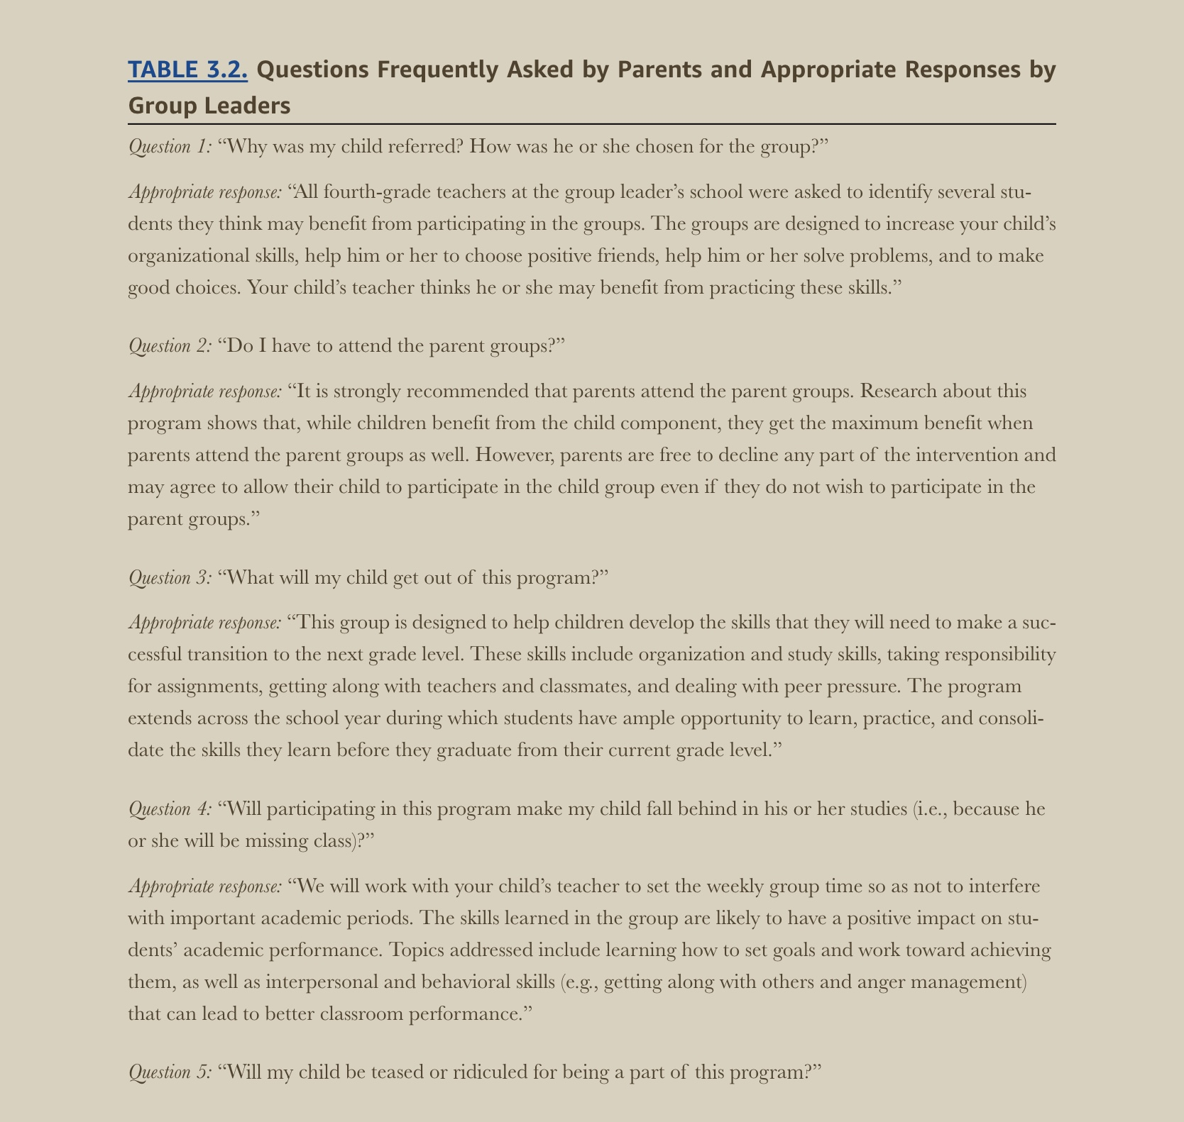
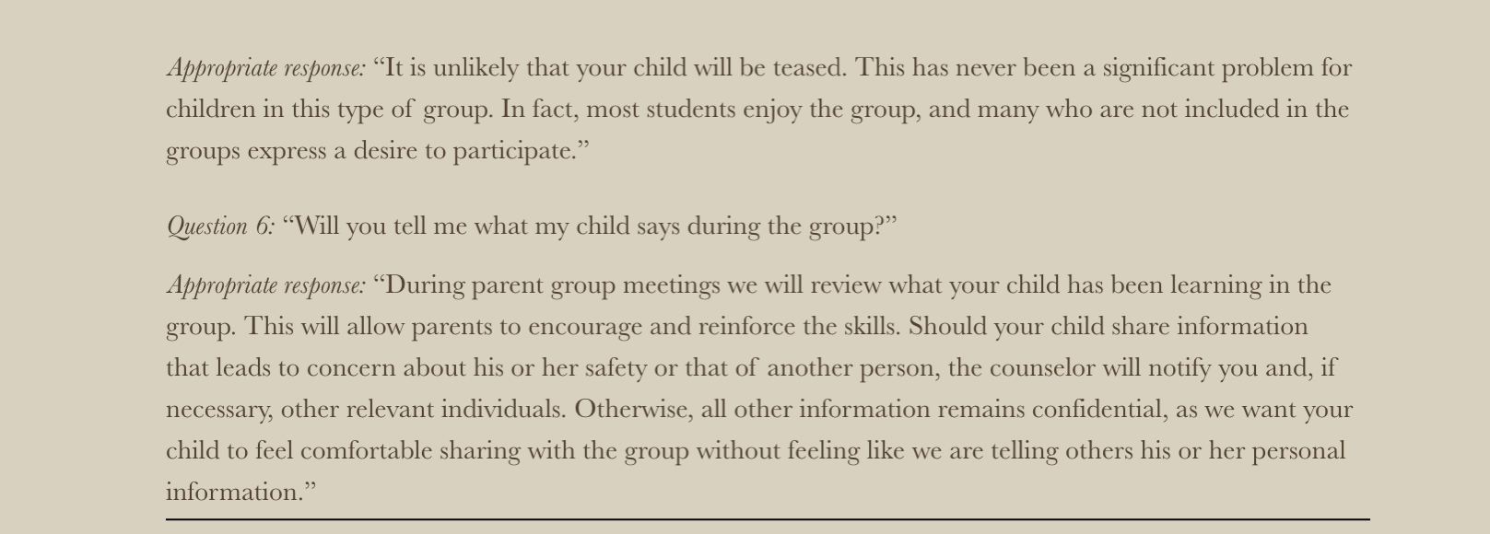

Slide 32
Recruiting for Parent Groups
Involving More Parents in the Group
Create fliers
Attend Back-to-School nights and other activities
Involve teachers

Slide 33
Recruiting for Parent Groups
Overcoming Parent Group Recruitment Barriers:
Difficulty Contacting Parents
Parent Time Constraints and Other Commitments
Finding Child Care
Transportation
Remembering Commitment to the Group
Uncertainty About the Group
Sending Home Materials
Multiple Caregivers
Notes:
Ask attendees what they would do to solve each of these problems.
Diff Cont. Parents: Detailed phone message, request they contact you to review, get # to reach them, talk to classroom teacher to see if parent comes to school or if they have any contact with you, arrange to stop by during parent meeting, call parent after peak hours, keep convos brief and offer to call diff # to save parent minutes, log times parent seems to be available.
If contact info incorrect, can send letter home w/ student asking for updated contact information, ask teacher/admin assistant for updated contact information, look at student emergency contact card as that contact may have up-to-date info, request correct info through Information (411; XXX-555-1212) or on whitepages.com.
Parent Time Constraints and Other Commitments: brainstorm, coming as often as possible, materials can be sent home after each group, discussing materials over phone, emailing materials, REVIEW** (especially advanced materials)
Finding CHild Care: provide resources if available (i.e., interns/externs), brainstorm individuals during initial recruitment convo, parent attends first group and talks to other parents about childcare
Transportation: providing bus token or taxi fare if possible, brainstorm their getting rides or connecting with other group members for transportation during initial recruitment convo, provide taxi company list w/ phone numbers and bus route/schedule info, encourage carpool
Remembering Commitment to the Group: provide parents w/ calendar showing dates/times of group meetings and a magnet for fridge, reminder phonecalls a day or two in advance or even morning of session, indiv meeting w/ parents to show how to use planner or add meetnig dates to their planner, reward for remembering to come to meeting (raffle ticket, praise)
Uncertainty About Group: identify parent concerns prior to group/in early stages, indiv meeting or phone convo w/ parents to explore expectations and discuss alignment or lack thereof, explain structure/purpose of group, generate list of expectations during initial group meeting and discuss what is and isn’t realistic.
Assure parents they are welcome and encourage trying out the first session. Send Reminder fliers and group materials each meeting w/ letter encouraging them to call if they’d like to review materials and contact info
Even if they seem committed from start, still ask parents about potential barriers to attendance and brainstorm solutions. Can lead to innovation even if they lack resources. Further, they will find ways to attend if they see group as helpful
Sending Home Materials: use clinical judgement regarding what materials to send home w/ parent (perhaps simple, but not complex materials) and make sure you’re not enabling missing session.
Encourage attendance at every opportunity (in person, phone, written correspondence. “We missed you” letters or those encouraging attendance, don’t want to make them feel guilt but convey you hope to see them at next session. Always empathize w/ stress and busy schedules (an excellent opportunity to build rapport)
Multiple Caregivers: in certain situations, recommended that informed consent be conducted with legal guardian but the primary caregiver could still be involved in the group, encouraging all caregivers to attend when possible. Consult w/ primary caregiver and legal guardian about who should be invited

Slide 34
Recruiting for Child/Parent Groups
Managing Your Time:
Prioritize recruitment
Block out time for administrative tasks
Challenge yourself to contact and engage families that are difficult to reach

Slide 35
Check-in
What are some additional ways that you can recruit for your group that have not already been mentioned in the slides?
What are some ways that should NOT go about recruiting for your group?
What are some challenges you might face when trying to involve different staff in the recruitment process?
Group Rules, Structure, and Logistics

Slide 36
Applied Practice!
Think about how you would respond to the following scenarios…

Slide 37
Scenario 1
A parent is not interested in his or her child participating in the group. The parent states that his or her child does not need the group. As the group leader, process the concerns that may be causing the lack of commitment to participating in the group.
Notes:
Pg. 35, Keperling

Slide 38
Scenario 2
The parent agrees that his or her child will benefit, but has a list of reasons why attending the parent group will be difficult. For instance, the parent has a full-time job and there are no groups offered during a convenient time. Or there could be no child care offered during the parent group. Try to come up with solutions to the barriers offered.
Notes:
Pg. 38 Keperling

Slide 39
Scenario 4
The parent is willing to have his or her child in the group, is interested in being in the parent group, and asks no difficult questions. As the group leader, process with the parent the barriers to attending a parent group.
Notes:
Pg. 39 Keperling

Slide 40
Reflection
How are the ideas and information presented connected to what you already knew?
What new ideas did you get that extended or broadened your thinking in new directions?
What challenges or puzzles have come up in your mind from the ideas and information presented?
Group Rules, Structure, and Logistics

Slide 41
Post-training survey
Please fill out the survey below regarding how you feel about your ability to implement group interventions with fidelity after completing this training.
Post-training Survey

Slide 42
Thank you!

Slide 43
References
Atkinson, D. R., Morten, G., & Sue, D. W. (1993). Within-group differences among racial/ethnic minorities. In D. R. Atkinson, G. Morten, & D. W. Sue (Eds.), Counseling American minorities: A cross-cultural perspective (4th ed., pp. 41–74). Madison, WI: Brown & Benchmark.
Caldairou-Bessette, P. (2015). M. J. Ratts & P. B. Pederson, Counseling for Multiculturalism and Social Justice: Integration, Theory and Application. Transcultural Psychiatry, 52(6). doi:10.1177/1363461515612353
Chao, R. C., Wei, M., Spanierman, L., Longo, J., & Northart, D. (2015). White racial attitudes and white empathy: The moderation of openness to diversity. The Counseling Psychologist, 43, 94 –120. http://dx.doi.org/ 10.1177/0011000014546871
Cross, T. L., B. J. Bazron, K. W. Dennis, and M. R. Isaacs. 1989. Towards a Culturally Competent System of Care: A Monograph on Effective Services for Minority Children Who Are Severely Emotionally Disturbed. Washington, DC: CASSP Technical Assistance Center, Georgetown University Child Development Center.
Keperling, J. P. (2017). Group interventions in schools: A guide for practitioners. New York, NY: The Guilford Press.
Marsella, A. J. (1993). Counseling and psychotherapy with Japanese Americans: Cross-cultural considerations. American Journal of Orthopsychiatry, 63(2), 200-208. doi:10.1037/h0079431
Parham, T. A., Ajamu, A., & White, J. L. (2011). Psychology of Blacks: Centering our perspectives in the African consciousness. Boston, MA: Prentice Hall.

Slide 44
References (Cont.)
Ponterotto, J. G., Utsey, S. O., & Pedersen, P. (2006). Preventing prejudice: A guide for counselors, educators, and parents. London: SAGE.
President’s Commission on Mental Health. (1979). Report from the President’s Commission on Mental Health. Washington, DC U. S. Government Printing Office.
Ratts, M. J., & Pedersen, P. B. (2014). Counseling for multiculturalism and social justice: Integration, theory, and application (4th ed.). Alexandria, VA: American Counseling Association.
Ratts, M. J., Singh, A. A., Nassar-McMillan, S., Butler, S. K., & McCullough, J. R. (2015a). Multicultural and Social Justice Counseling Competencies. Retrieved from http://www. counseling.org/docs/default-source/competencies/multicultural-and-social-justicecounseling-competencies.pdf?sfvrsn=201
Ridley, C. R. (2005). Overcoming unintentional racism in counseling and therapy: A practitioner's guide to intentional intervention. Thousand Oaks, CA: Sage.
Sue, D. W., & Sue, D. (2016). Counseling the culturally diverse: Theory and practice. Hoboken, NJ: John Wiley & Sons.
Sue, D. W., & Torino, G. C. (2005). Racial– cultural competence: Awareness, knowledge, and skills. In R. T. Carter (Ed.), Handbook of racial– cultural psychology and counseling: Vol. 2. Training and practice (pp. 3–18). Hoboken, NJ: Wiley.
Thomas A, Sillen S. Racism and psychiatry. New York: Citadel Press; 1991. Original work published 1972.

